Slide 1



Presented By : Commit_Crew
SkillBridge
For : INNOVATEX 2025 Hackathon
Team Members:
Md. Atikul Islam Atik – System Designer
Md. Yasin Hossain Akash – Frontend Developer
Md.Siratul Islam - Backend Developer
Sultana Rupa - Frontend Developer
by UAP
1

Slide 2

Problem Statement
01
Industry Needs vs Graduate Readiness
03
Academic-Industry Gap
02
Missed Opportunities
Lack of Soft Skills Training
04
2

Slide 3
Proposed Solutions
Real-World, Industry-Curated Tasks
Secure and Flexible Task Delivery
Role‑Based Dashboards
Tasks created and verified by industry experts
Integrated directly into university curriculum or open to independent learners
Enhances employability through hands-on experience
Online Mode: Proctored task attempts with integrity safeguards
Offline Mode: Supervised physical task completion
Ensures fairness and real-world simulation
Super Admin
Industry
University
Student / Individual Learners
3

Slide 4
Proposed Solutions
Credit & Subscription Model
Engagement & Analytics
Roadmap Enhancements
AI‑powered task recommendations, job‑portal integration, advanced reporting
Allowing universities to purchase task‑credits and companies to monetize challenges
With leaderboards and usage insights
4

Slide 5
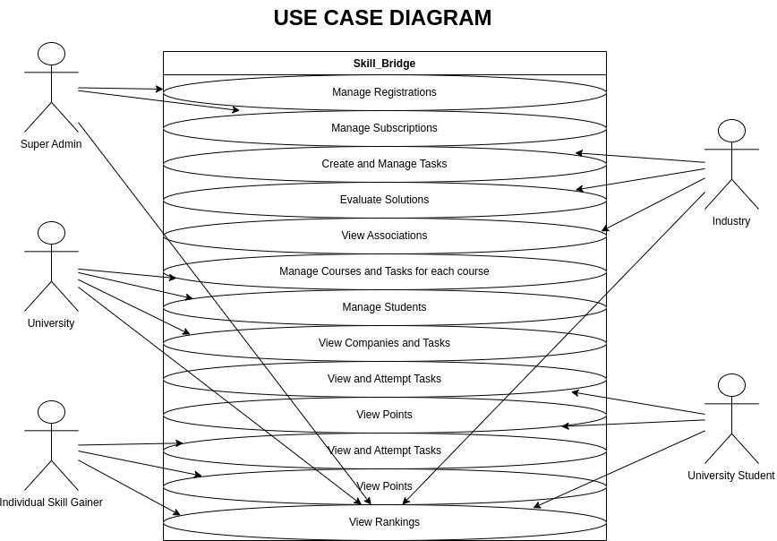
5

Slide 6
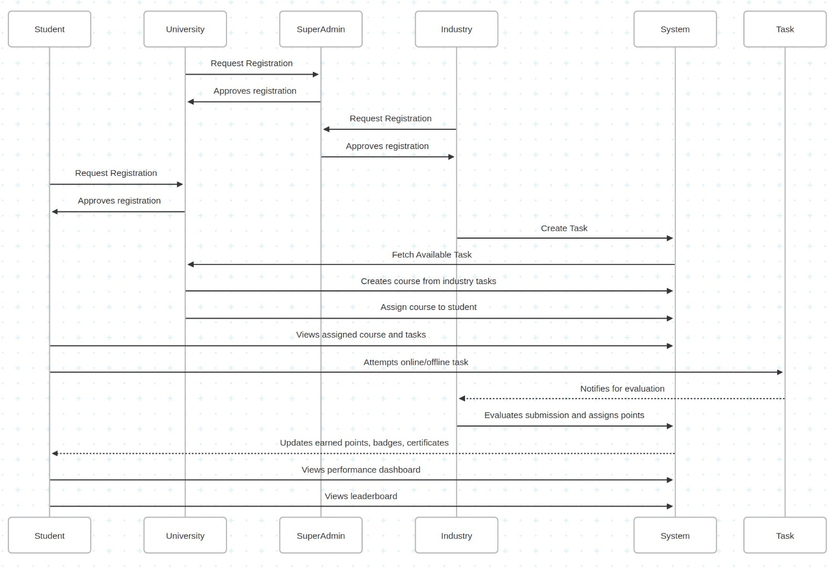
Sequence
6

Slide 7
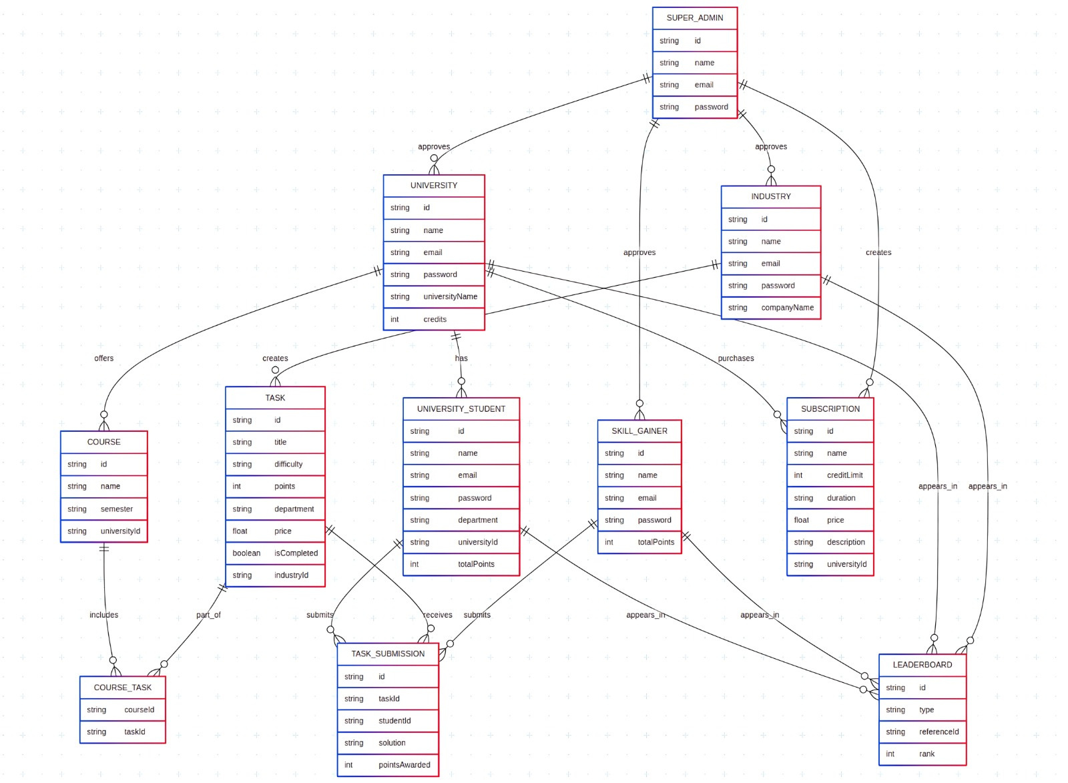
ER Diagram
7

Slide 8
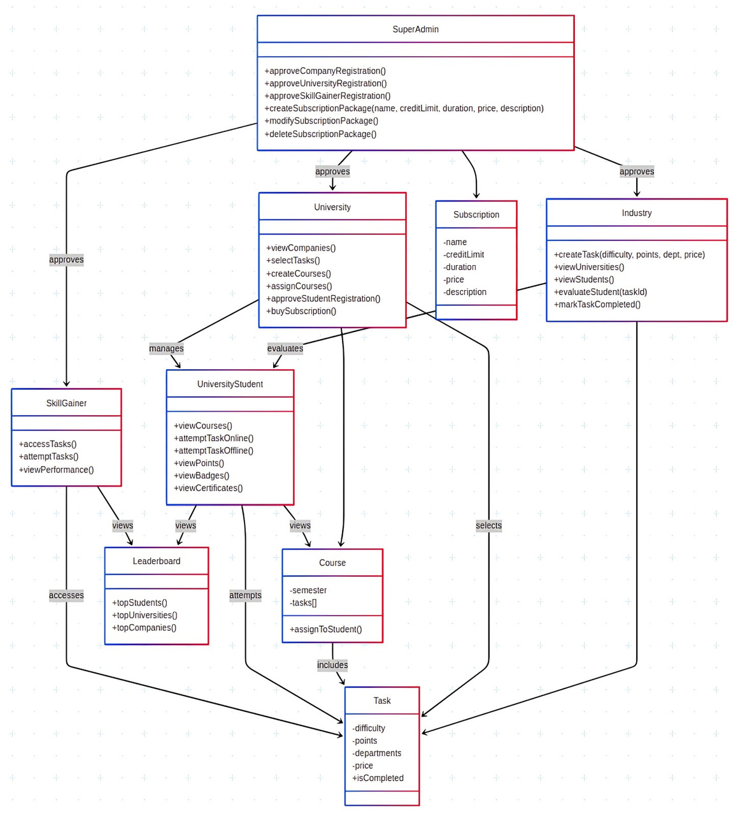
Class Diagram
8

Slide 9
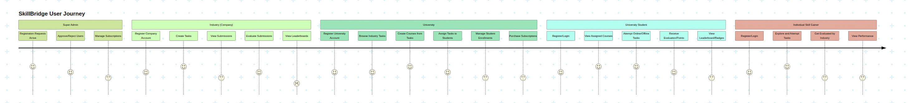
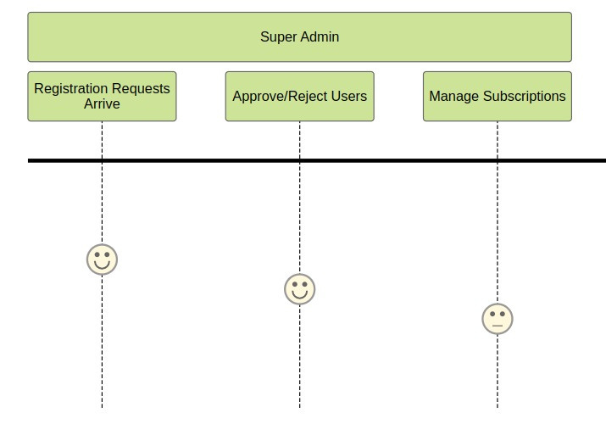
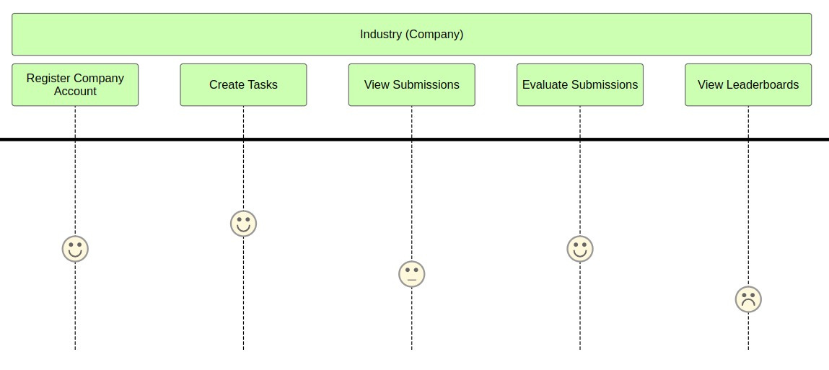
User Journey
9

Slide 10
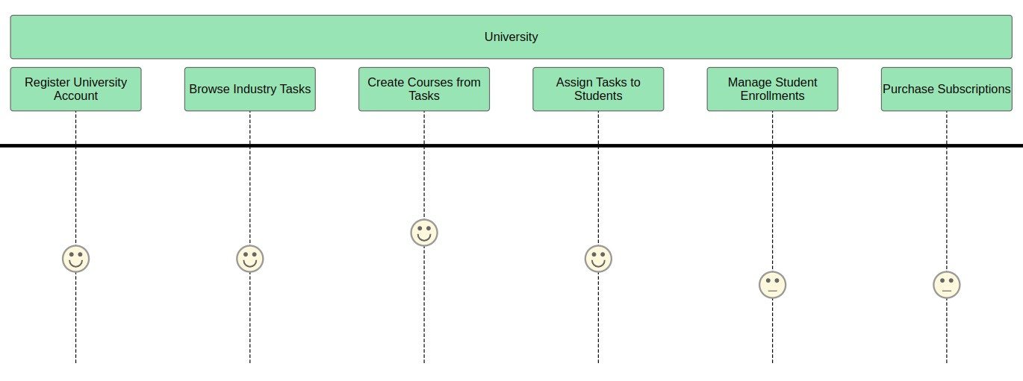
User Journey
10

Slide 11
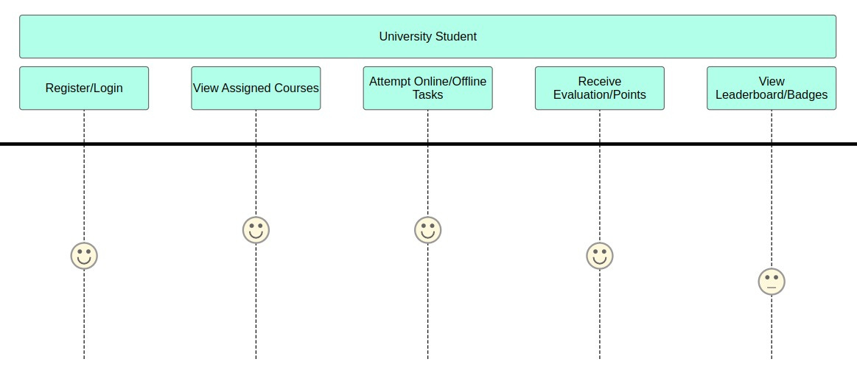
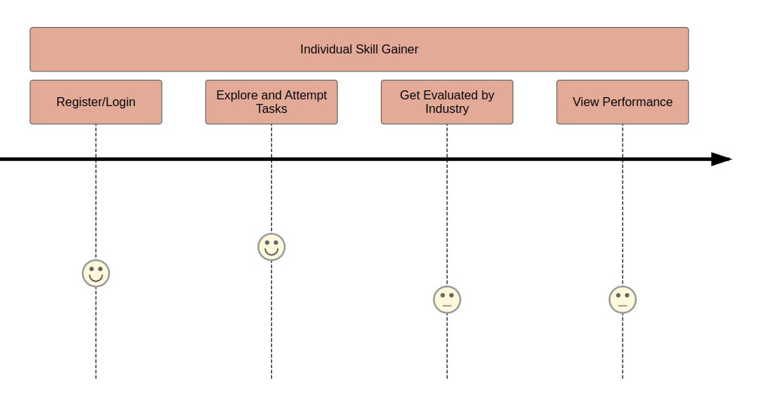
User Journey
11

Slide 12
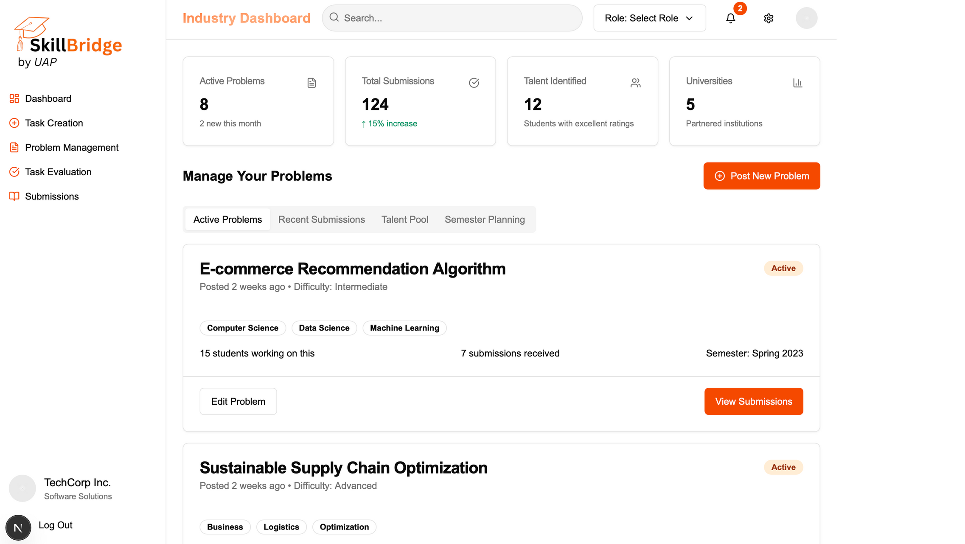
12

Slide 13
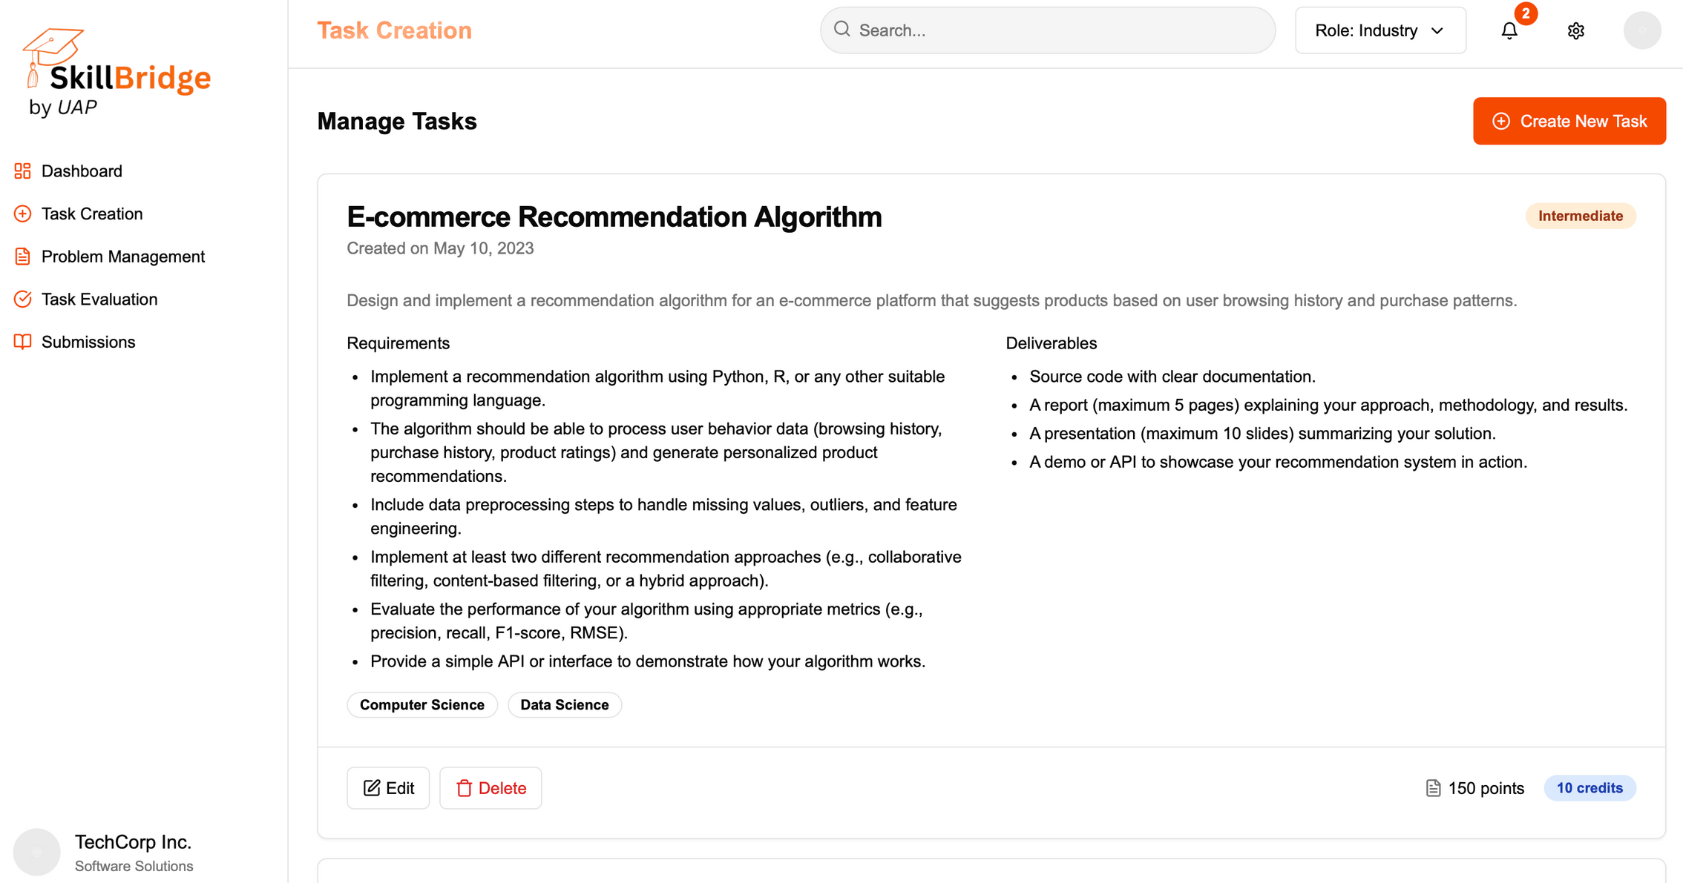
13

Slide 14
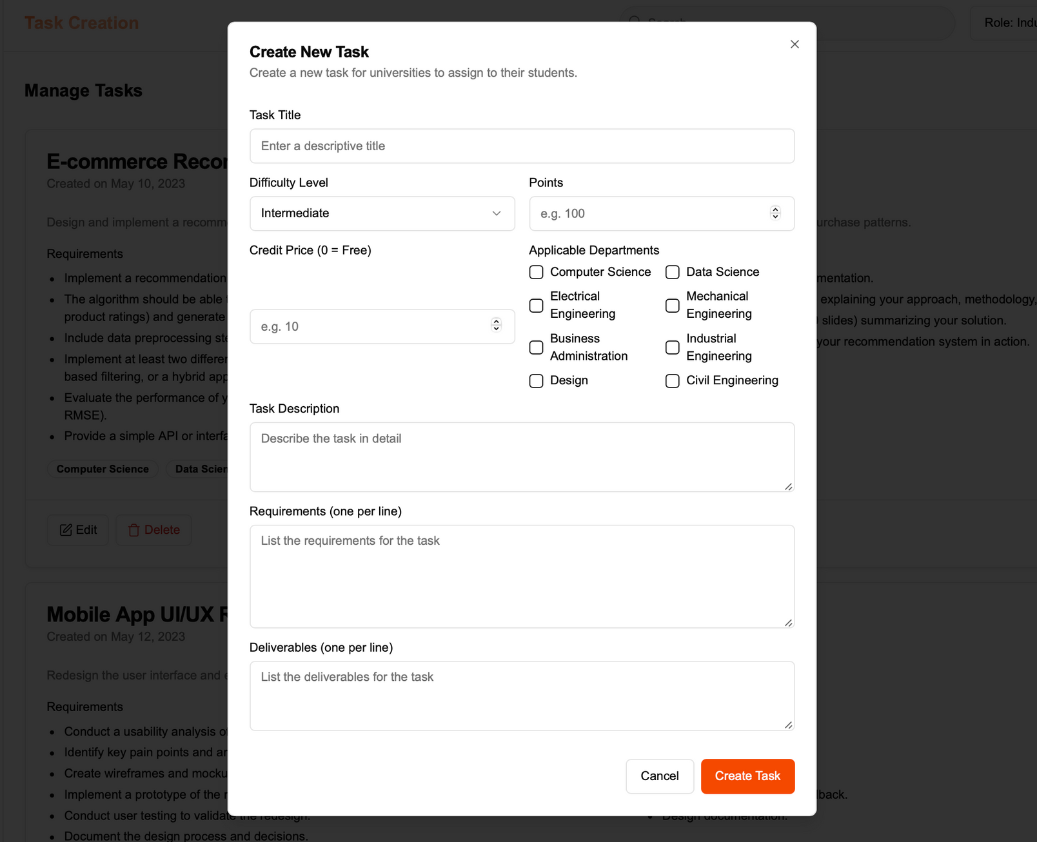
14

Slide 15
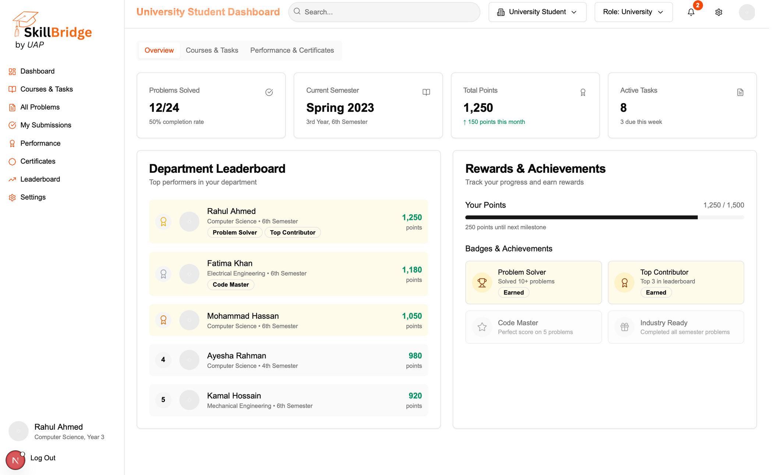
15

Slide 16
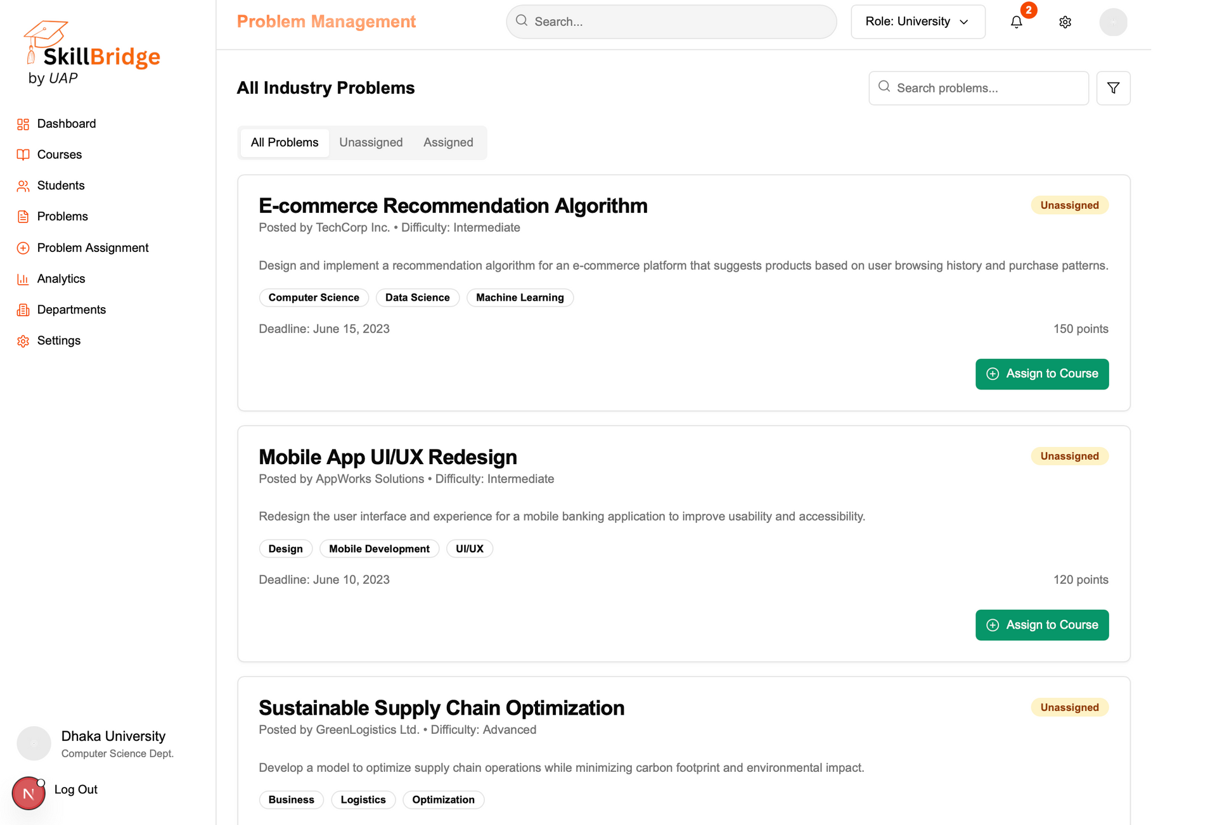
16

Slide 17
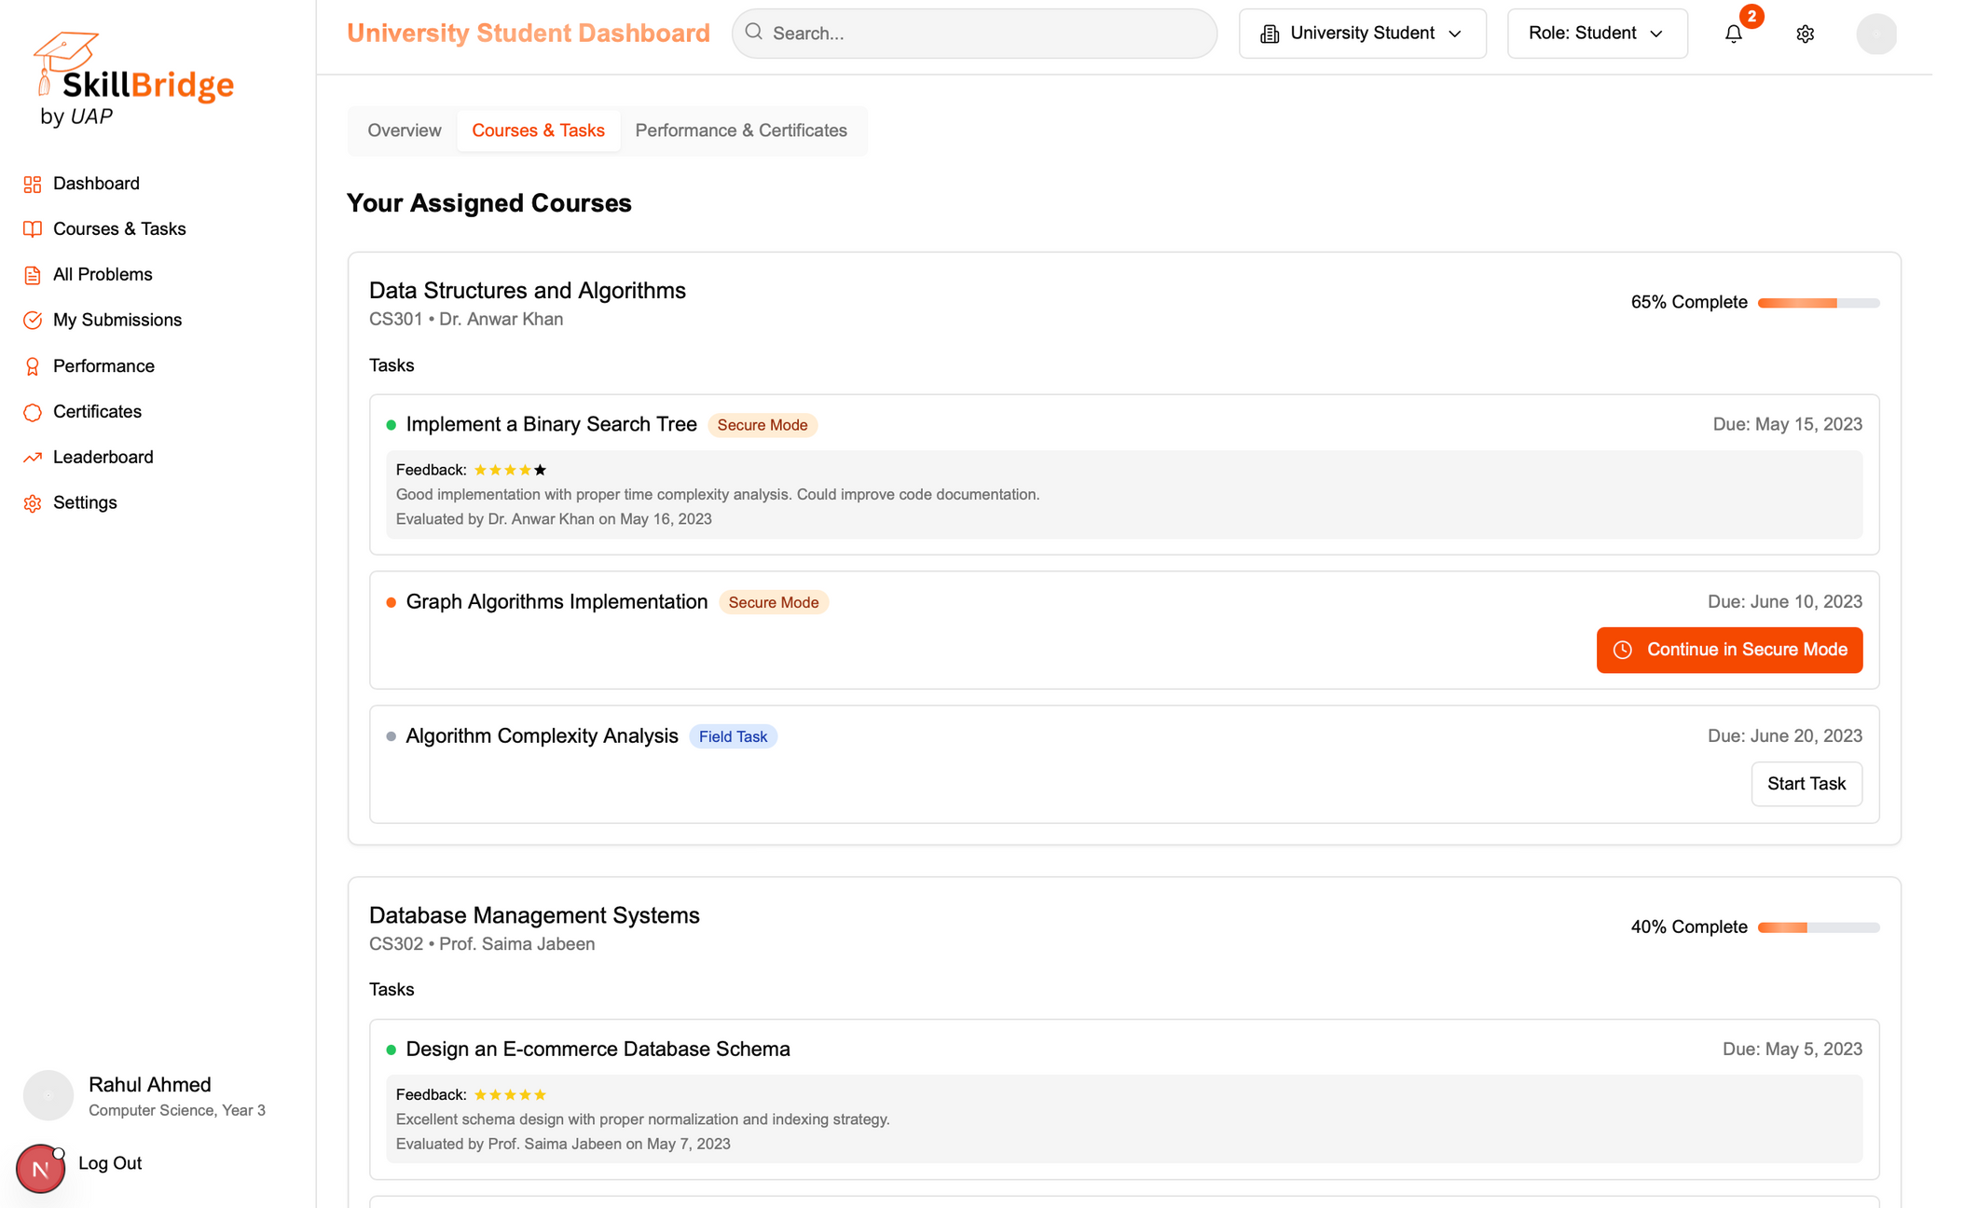
177

Slide 18
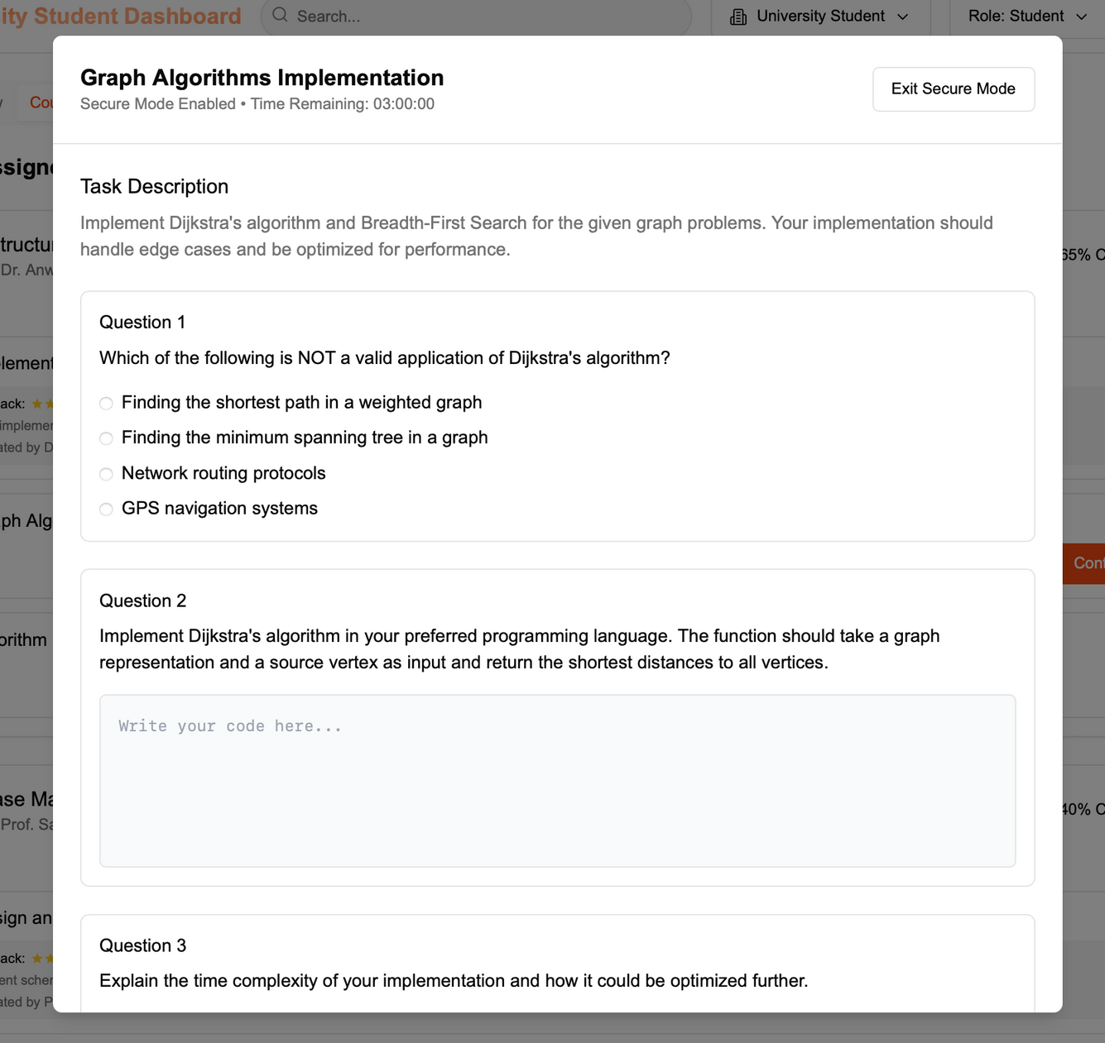
18

Slide 19
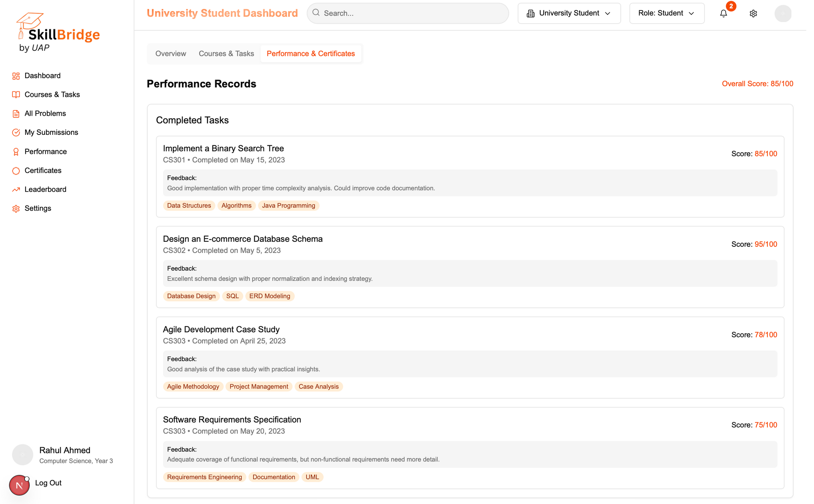
19

Slide 20
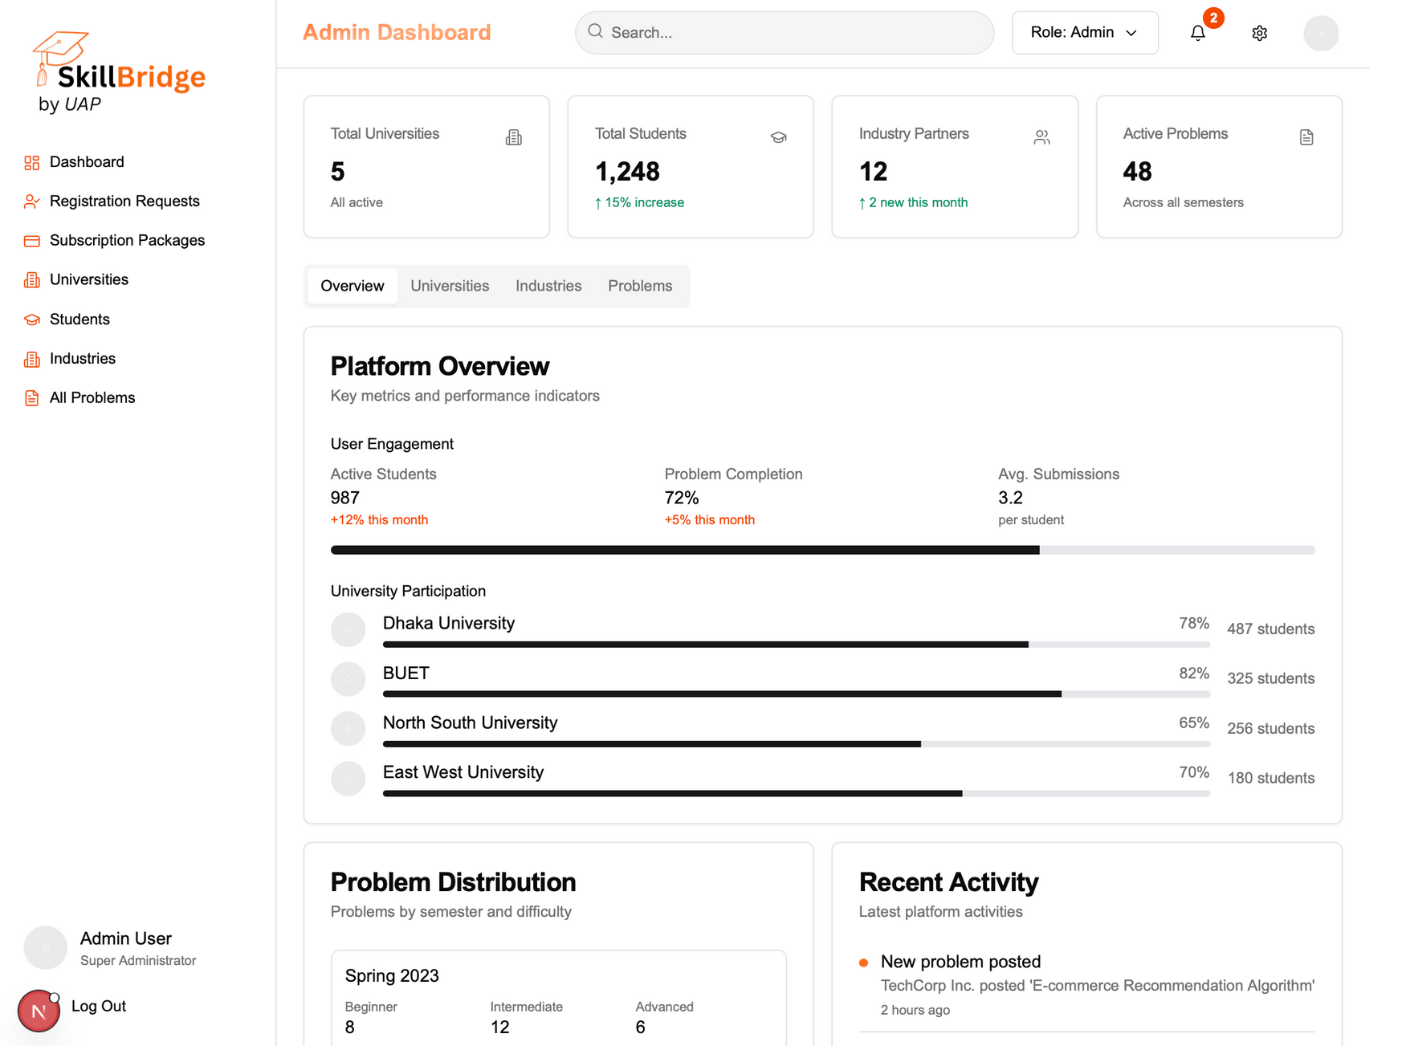
20

Slide 21
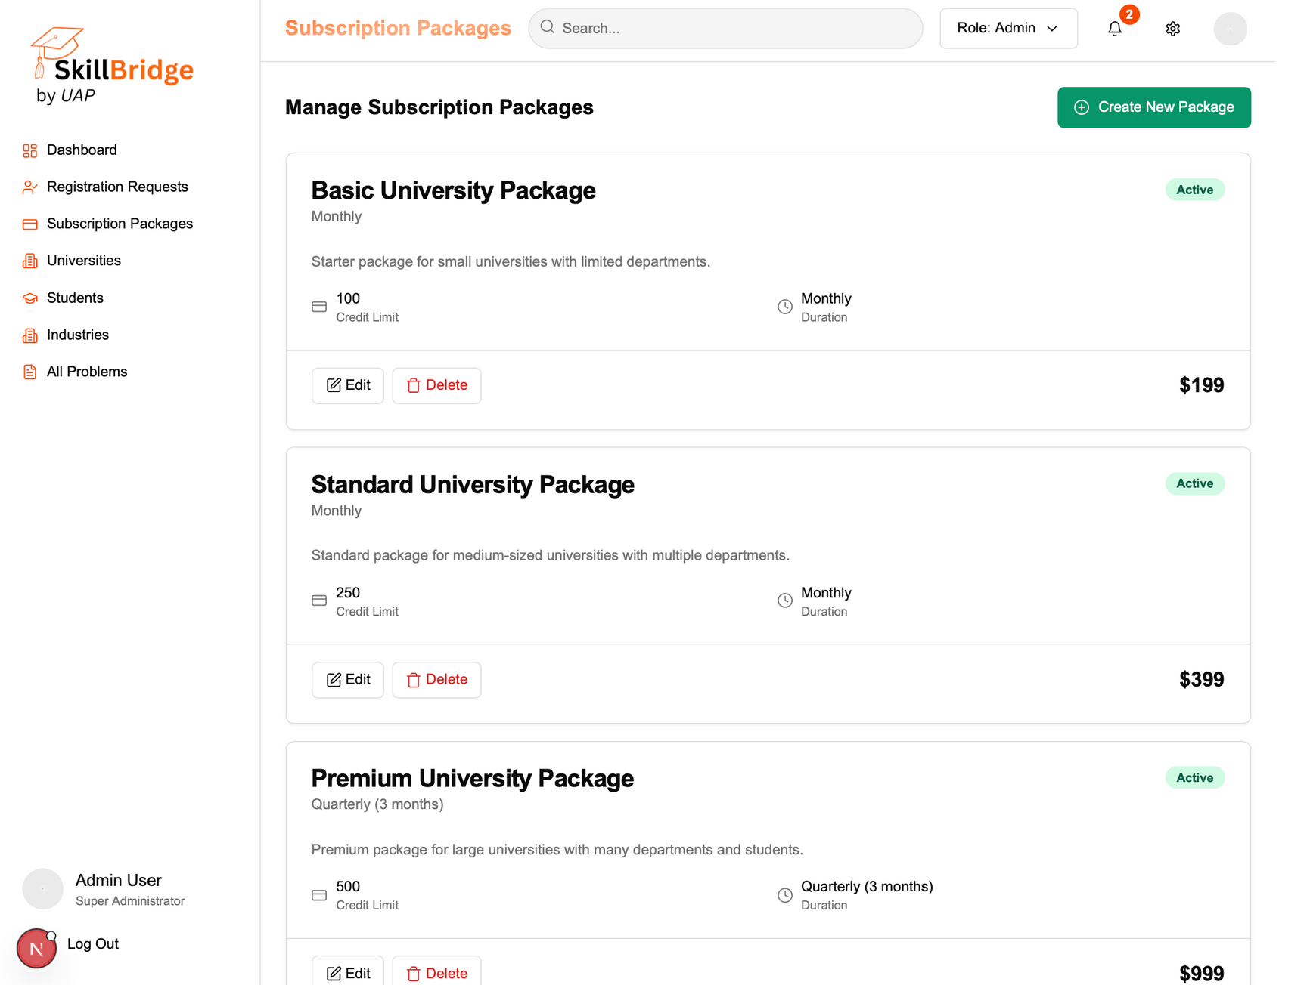
21

Slide 22
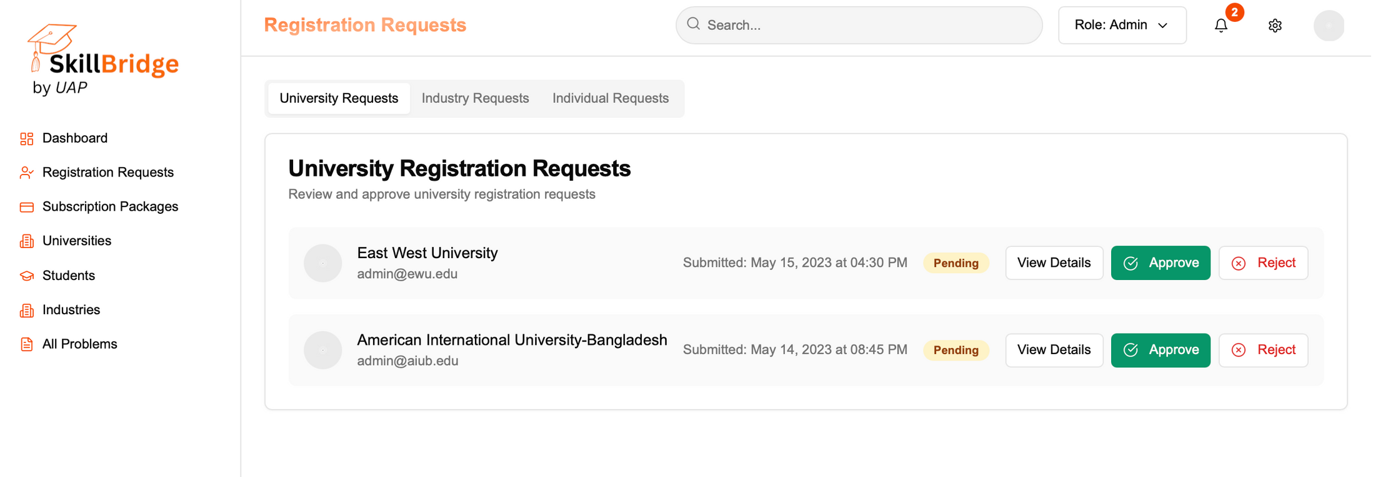
22

Slide 23
KEY TAKEAWAYS
Real‑World Learning ⊕ Industry‑sourced challenges become credit‑bearing coursework or standalone skill modules
Role‑Based Platform ⊕ Distinct dashboards empower Admins, Companies, Universities, and Learners
Secure & Flexible Delivery ⊕ Online proctoring or supervised offline modes ensure integrity
Sustainable Ecosystem ⊕ Subscription‑based credits fuel company monetization and university partnerships
Scalable Architecture ⊕ Designed for 99.5%+ uptime and sub‑3 s responsiveness
23

Slide 24
SkillBridge
by UAP
THANK YOU
Any Question ?
24

